Slide 1
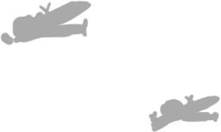
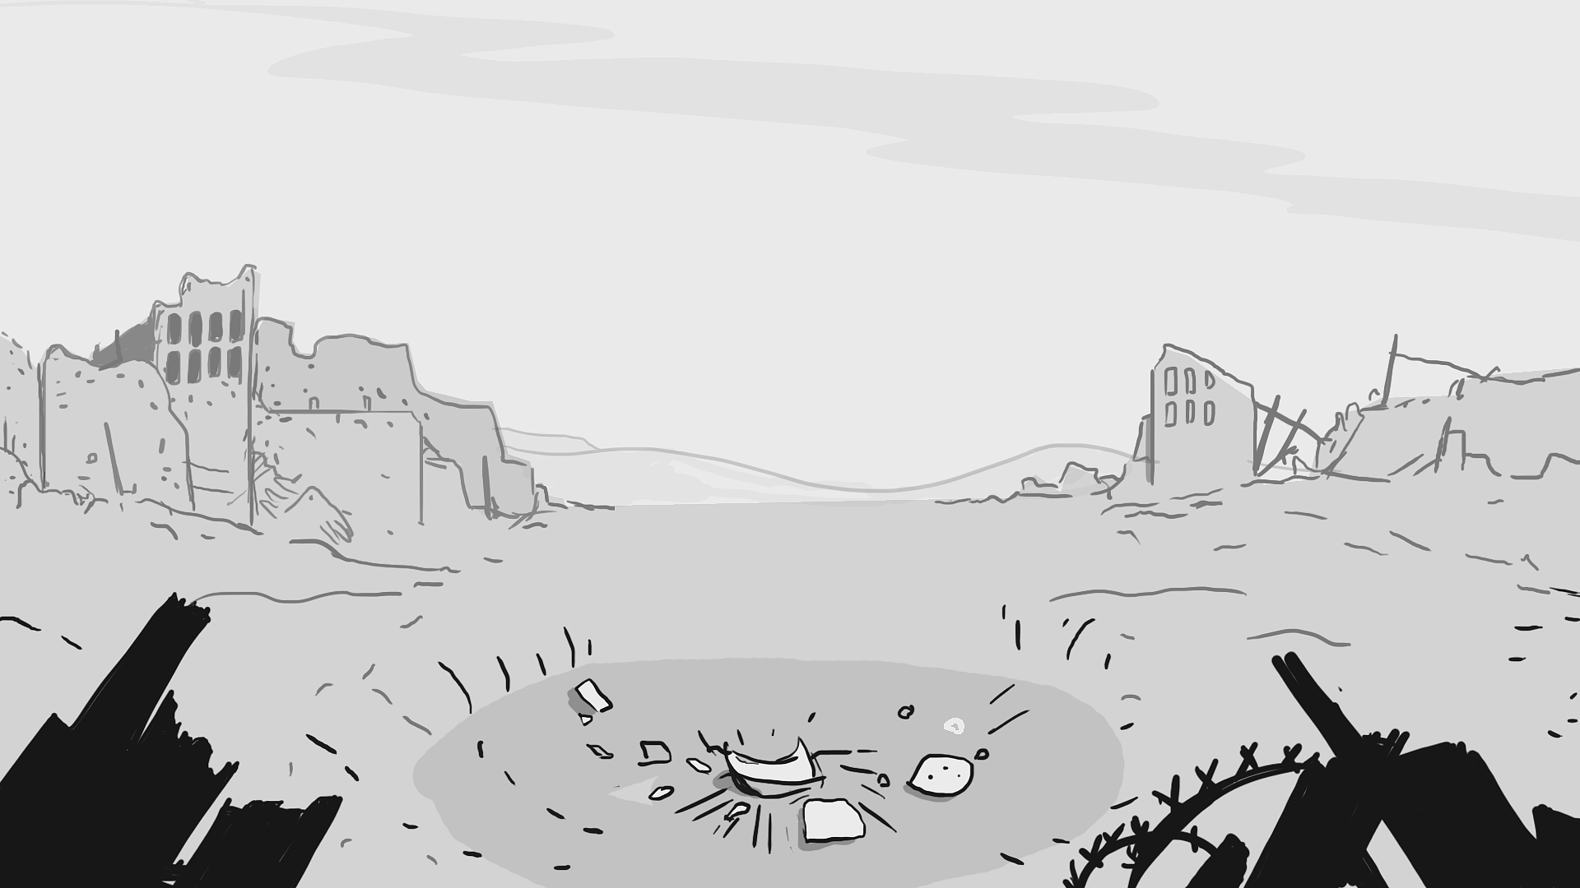


Title card - Luis Brito
Luis Brito
Notes:
Hello Everyone! My name is Luis, and today I’d like to present to you... New Orders. What is New Orders?

Slide 2
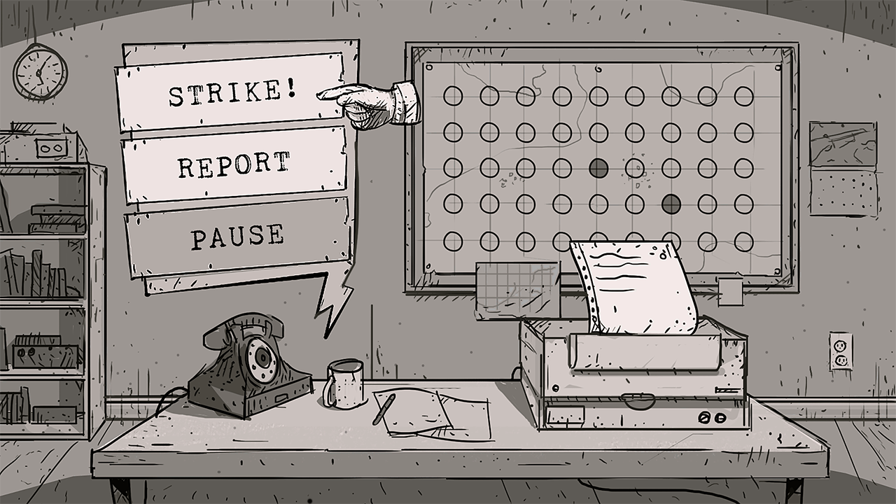
Notes:
New Orders is an interactive puzzle adventure game that challenges players to make difficult decisions while navigating themselves through one of the most intense conflicts in recent memory, the Korean War.

Slide 3

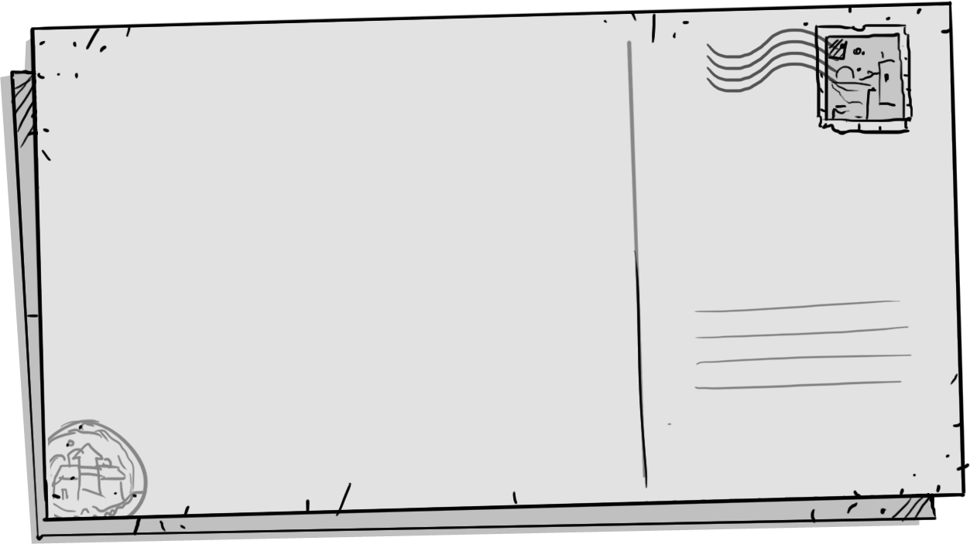
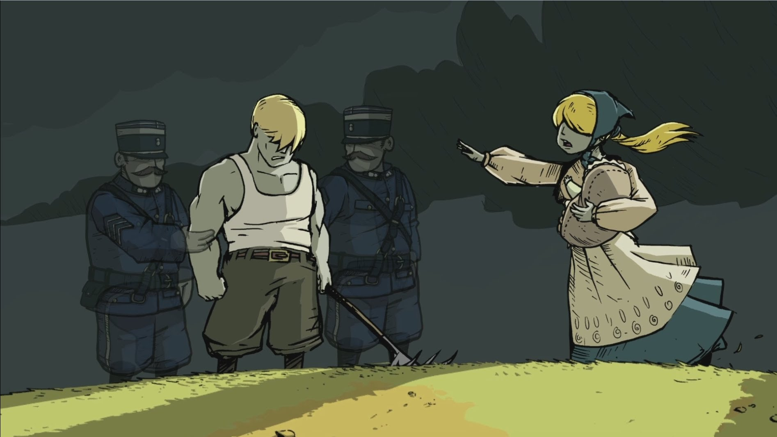
Inspiration
Notes:
Inspired by existing titles like Papers Please, This War of Mine, and Valiant hearts, I wanted to design an experience that tells a story in a subtle way with a lasting impact

Slide 4
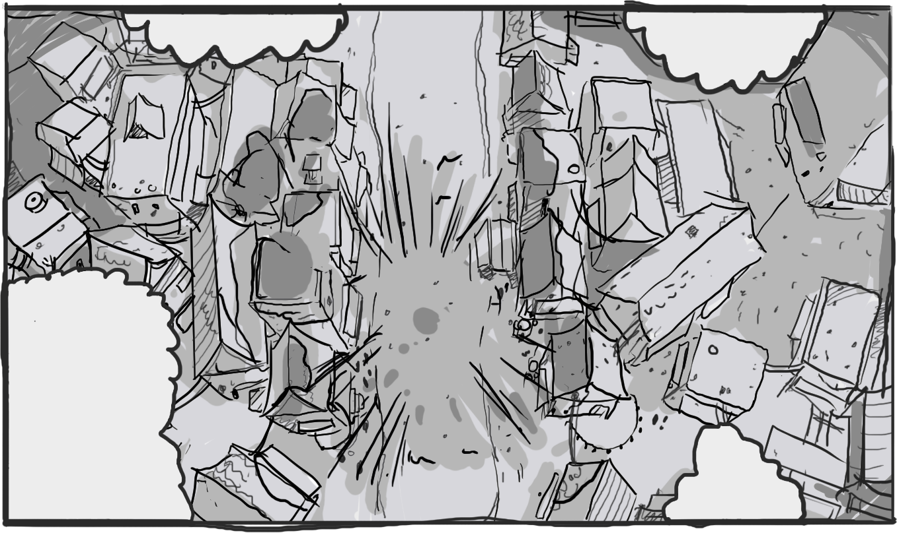
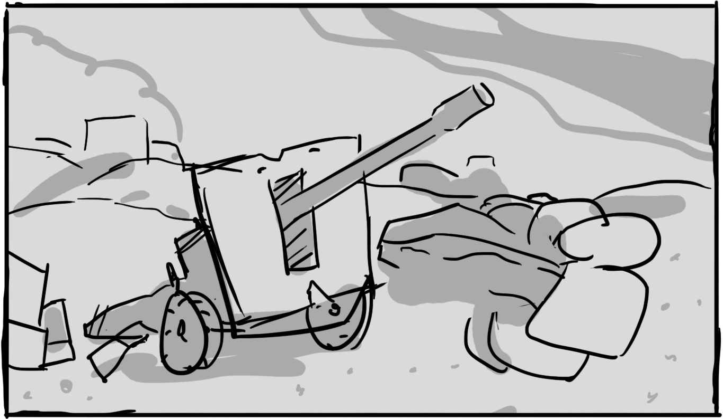
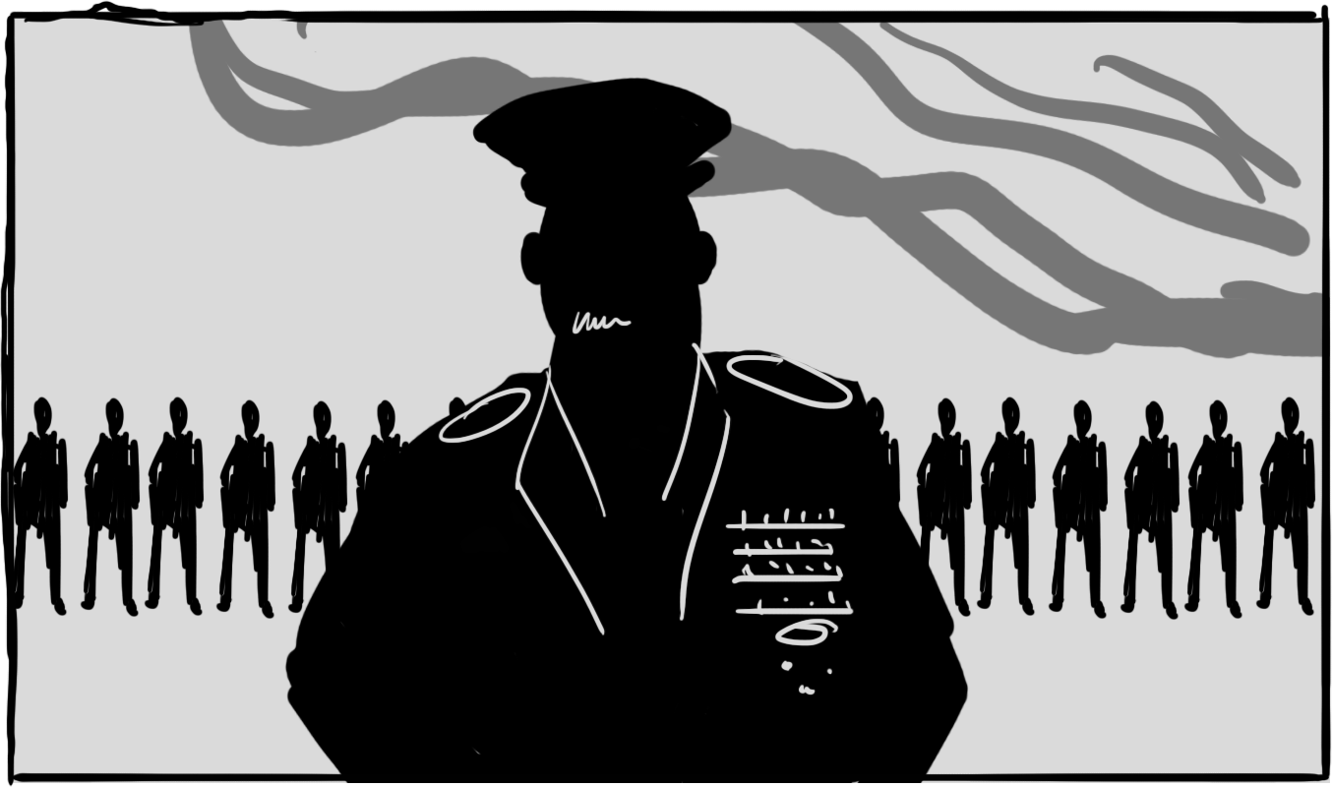
Notes:
The player assumes the role of an unwilling participant in a conflict. They must hear info and stories from the battlefield, use tools to solve clues, then determine where to send artillery.

Slide 5
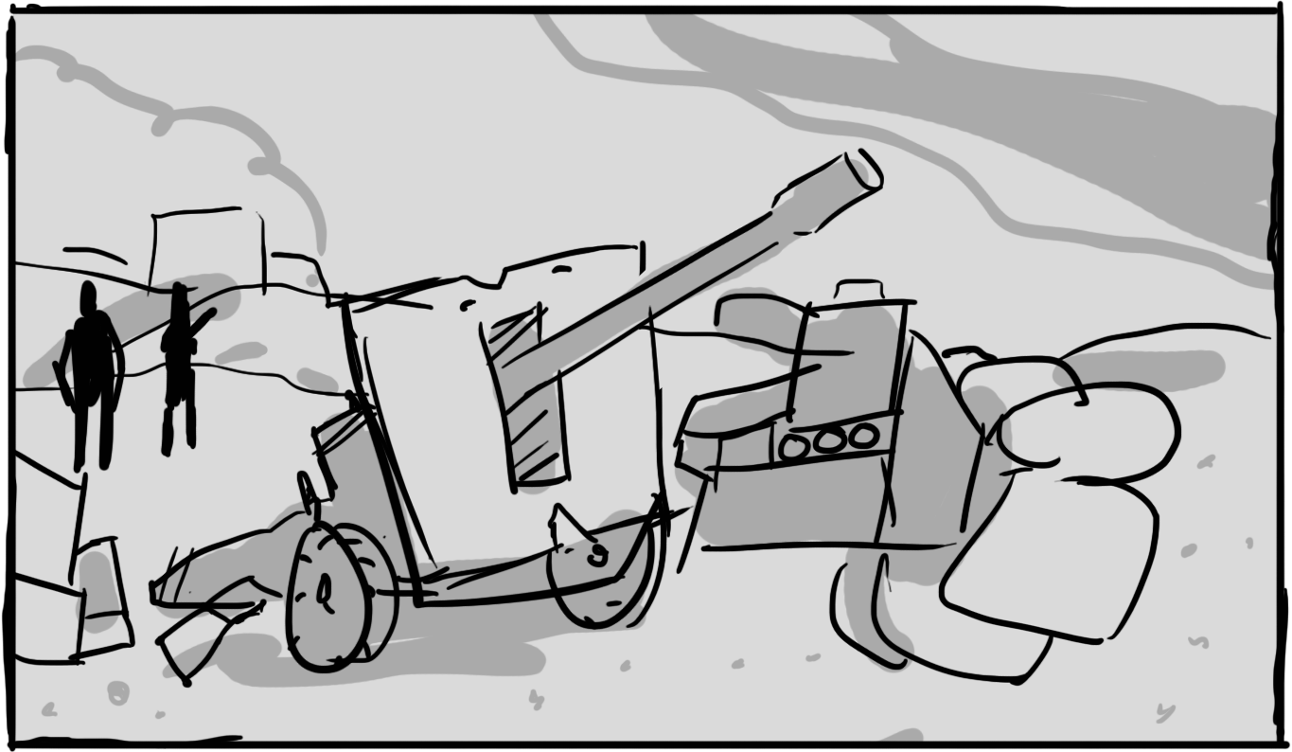
Inspiration
Notes:
Do you obey every order and do what’s good for your team?

Slide 6
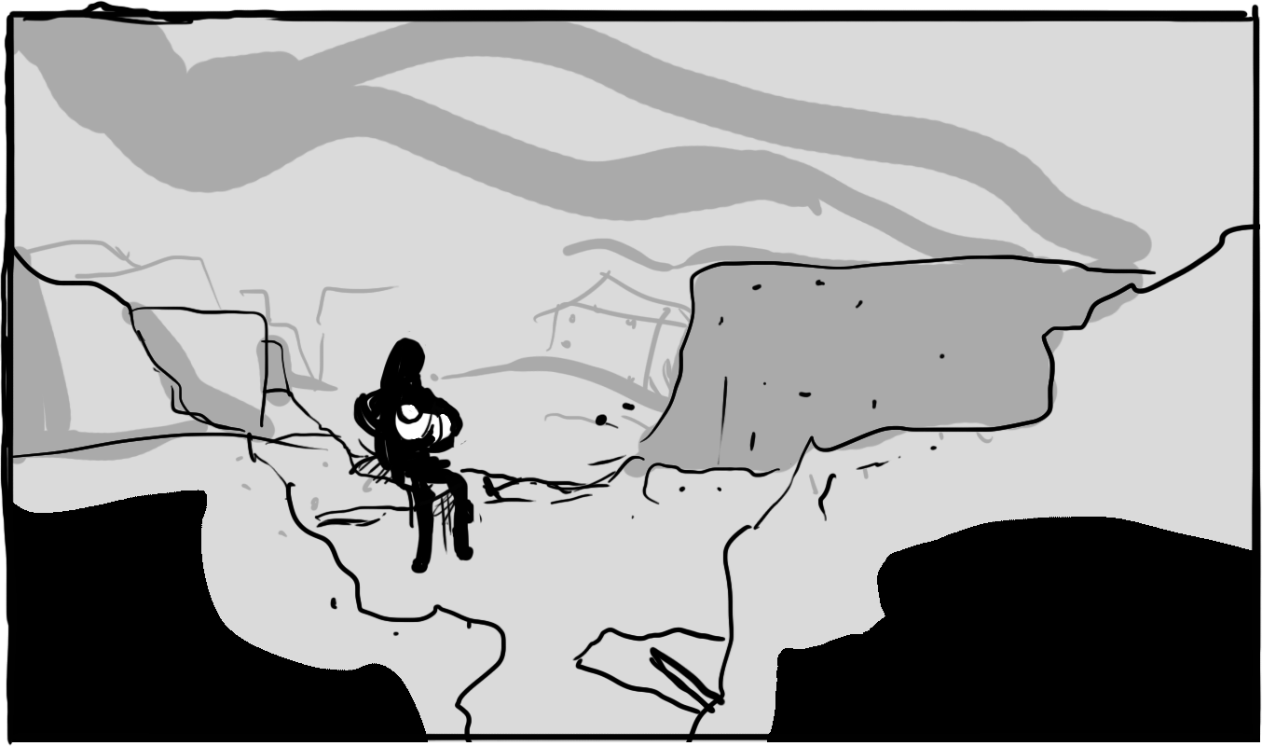
Notes:
Or do you help the defenseless and mislead your superiors?

Slide 7

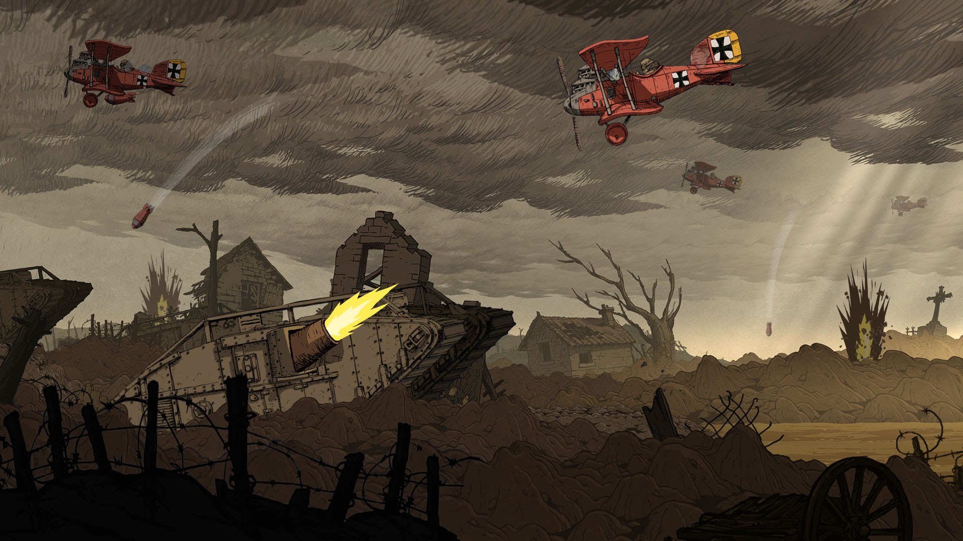
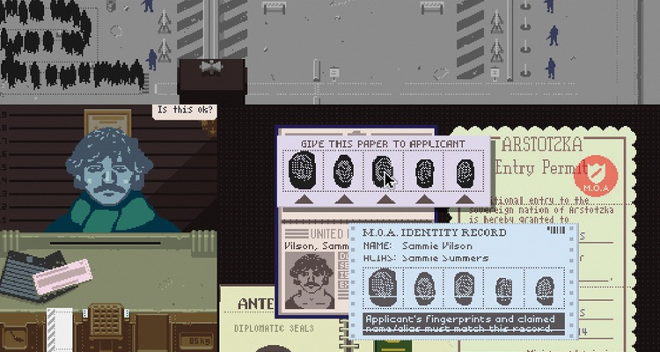
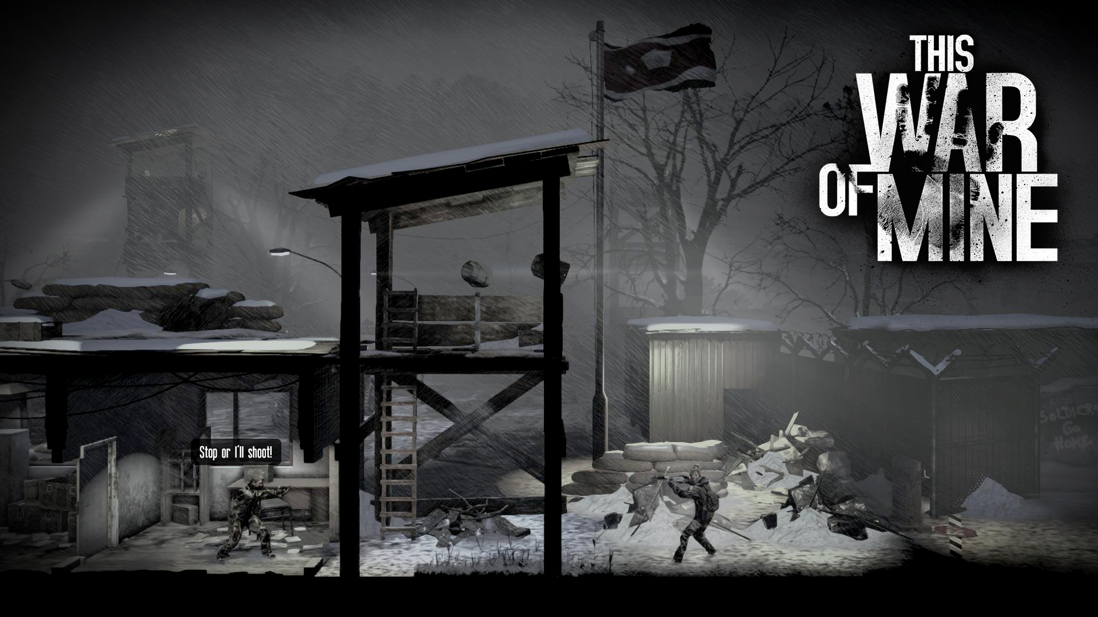

Competition
Notes:
One thing that I noticed with all of these inspirations is that they capitalized on player choices and decisions directly influencing gameplay. In order to make serious games appealing, you have to make the tough decisions in the stories the PLAYERS decisions. The learning experiences and character growth has to also be the player’s growth.

Slide 8

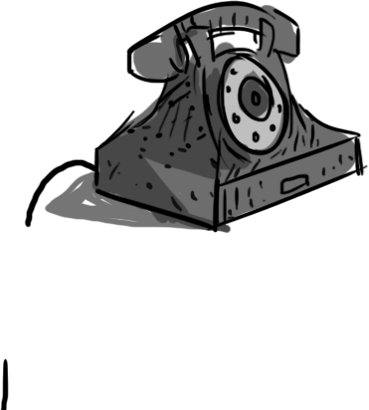
How?
Notes:
How do we do that?

Slide 9
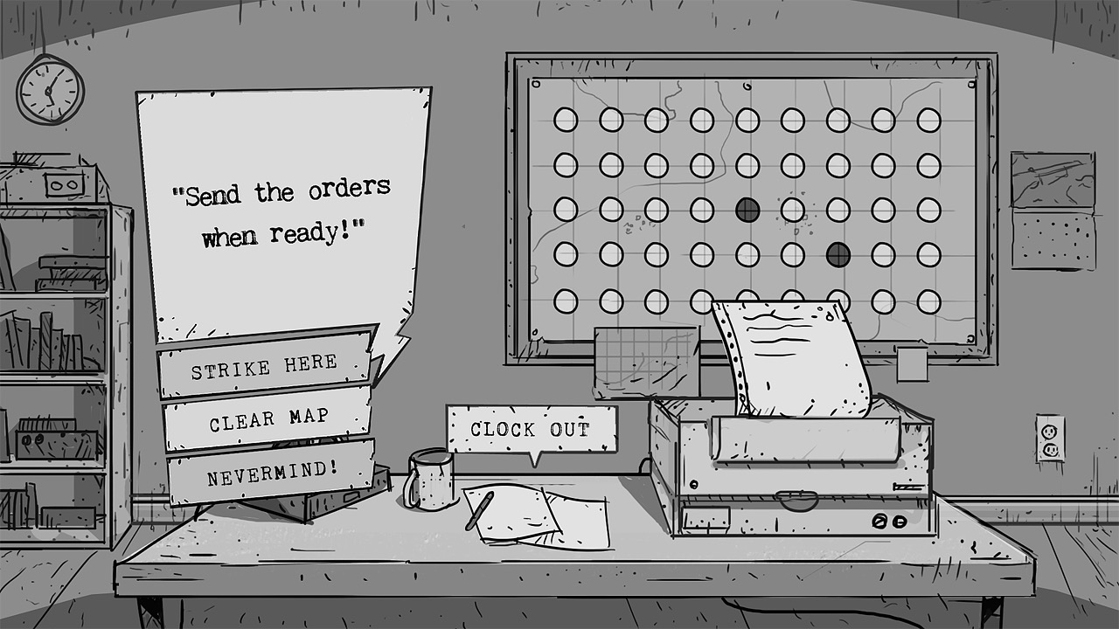

Gameplay
Take info from the front
Solve puzzles
& transcribe
Send Orders to
your squad
Notes:
Gameplay! Players will be able to play through exciting battles. Military confrontations, moments of desparation, escape attempts, and espionage action are just some of the scenarios that may occur on a player’s playthrough. Each play of the game is randomized and set according to the previous experience of the player. With multiple endings, unique encounters, and game changing scenarios, players will constantly have to learn and adapt to the changing circumstances of the battlefield.

Slide 10
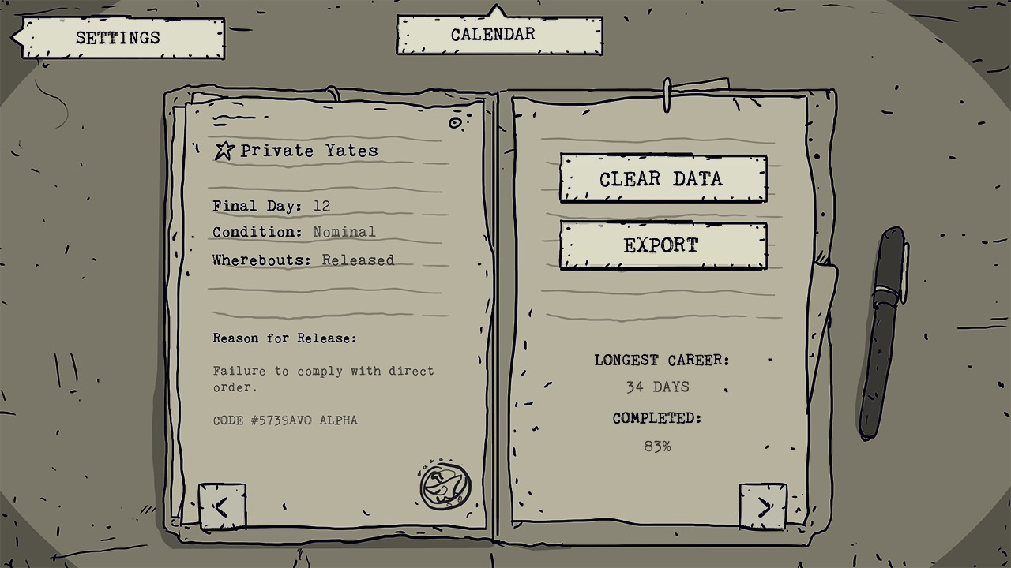
Inspiration
Notes:
New Orders keeps track of all of the decisions made by the player! Each playthrough logs the decisions, encounters, and condition of the player as they progress through the story. New Orders players will be able to compare their military careers online, collaborate to uncover secret events and happenings, and put together the pieces in a comprehensive format that details the Korean War in most of its known entirety.

Slide 11
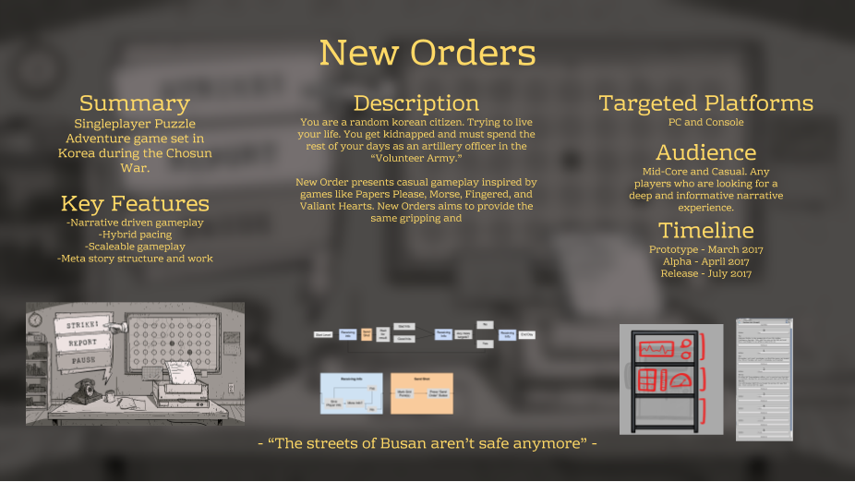
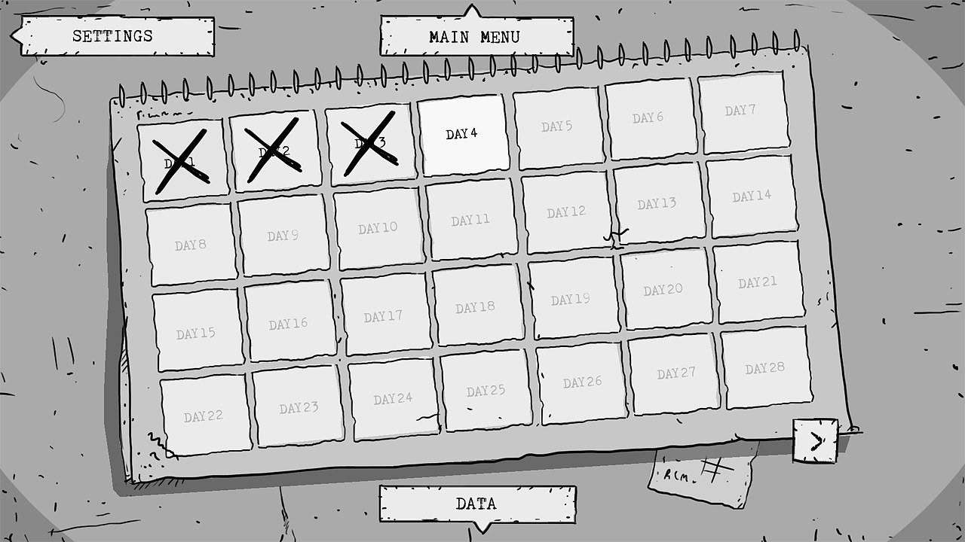
Production
Demo Available
Beta Stage
Full Tools
Alpha - May 2
Code Complete
Release - July
Notes:
New Orders is currently in the Beta Stage. A basic game demo is available, and I am constantly having the game tested and iterated on. Because of the nature of the game, as well as how much progress is already made, New Orders will reach Alpha stage by May 2nd. Alpha will continue throughout May and June, with Alpha transitioning to full release candidate somewhere in July. Tools and pipelines have already been established to better streamline the development process.

Slide 12




Platform
Mobile focused
Easy to port
Additional Content
Replayability
& Longevity
Notes:
New Orders will initially be available on mobile and tablet platforms. With the intuitive design, UI based gameplay, and accessibility in mind, the game can be easily ported to consoles with a few tweaks and changes based off of feedback. I have already established a relationship with several platforms, and am familiar with the requirements of deploying to each. Costs of development, contractors, and dev kits incurred will be settled using initial funding from the Mobile Game Competition, with additional support being provided by profits from each platform as the game is rolled out. Pricing models and Marketing plans have been written up on contract by a third party, and a small percentage of the profits from New Orders will be dedicated to relief and aid programs around the world.

Slide 13





Outreach
Festival
Submissions
Promoting
Awareness
Charitable
Donations
Notes:
New Orders has already been submitted to the Games 4 Change Festival, Terminus Storytelling Festival, E3 Student Game Competition, and the GMU Senior Game Expo. In the upcoming weeks, I’d like to continue submitting it to events like the Serious Play Conference, Indie Megabooth, and other assorted events where available. What started as a student project has quickly grown both in size and meaning. I’d like to present New Orders as not only a fun, engaging experience, but also a way of helping players better understand an important aspect of the lives of many of those around them.

Slide 14
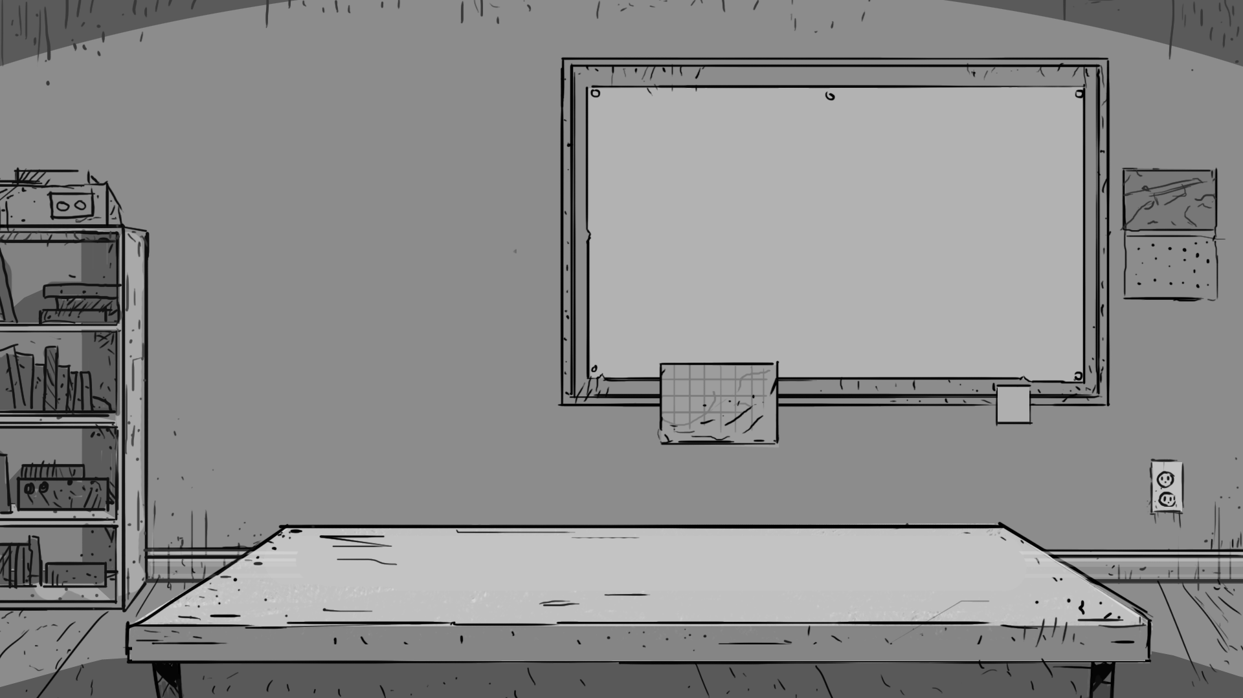
Thank You!
Luis Brito - lbrito2@gmu.edu
Notes:
That’s New Orders! Thank you for watching my presentation. I look forward to any questions, feedback, or considerations that you may have about the game.

